Slide 1
TsundokuBR
Venniz Valente

Slide 2
What is tsundokubr?
TsundokuBr aims to tackle the issue that revolves around “Tsundoku” which is the ideology of buying books, not reading them and buying more books and “Choice Overload” the inability to decide due to an excessive number of options available.
TsundokuBR has been designed and developed to ensure that readers of the Reading Community, specifically users of #BookTok are able to effectively log their TBR books onto a system that encourages mindful, fun and recreational reading.
Existing applications these days have made reading books feel competitive and challenging, users often comparing how many books they have read to other people but not considering the amount of time an individual takes to read.
Therefore, TsundokuBR will help users manage large TBR piles into feasible amounts catered to an individuals taste and availability.

Slide 3
How does TBR encourage recreational reading?
Eliminate Choice Overloading
Creating a playful way to encourage readers to go to their physical TBR shelf and select a book by…
Closing your eyes and pointing at x random books.
Choosing the first x books that you look at that makes you happy.
Choosing the first x books you see that are the most aesthetically pleasing.
Time is just a Concept
Reading challenges are competitive… I read 104 books in 1 year…
The Time Bubble Frame:
Allows the user to turn it off and on, giving readers a chance to read without a strict deadline.
Allows the user to start and stop, giving readers control of their own time.
Mindful Guidance
Lead by example by providing a guide to suggest a flexible structure to encourage not to dishearten.
Let them know so they can go with the flow… The average reader reads 200-400 words per minute, The average reader reads for 20 minutes a day, that’s about 8-16 pages a day.

Slide 4
TsundokuBR Technology Stack
My choice of technology stack through careful consideration and comparison are the choices below, this technology stack is not only popular and is widely used in industry which means plenty of documentation available online but also all the components I have chosen allow for seamless integration with one another.
Another reason why I have chosen these components is because I have personally never used React before and thought that this would be a great learning opportunity to expand my skills and knowledge.
To make TsundokuBR’s interface less code complex I want to integrate the usage of React Bootstrap.
Google Books API
React
Node.js
Express
API for Book Data
Frontend
Backend
Web Application Framework
Mocha
Visual Studio Code
MySQL
React Bootstrap
JavaScript Testing Framework
Coding Environment
Database
JavaScript Library

Slide 5
Implementation goals I have Achieved So far
3 Functionalities
Time Bubble Frame
Reading Level Selection
Time Bubble Frame
Google Books API Calls
Create an option to let the user decide if they want a certain time bubble frame for a select number of books to read within their TBR shelf.
Reading Level Selection
Google Books API Calls
Light, Moderate, and Heavy
Select a level and obtain a suggested guide for book amounts and time bubble frames.
Make calls to retrieve book data from the API.

Slide 6
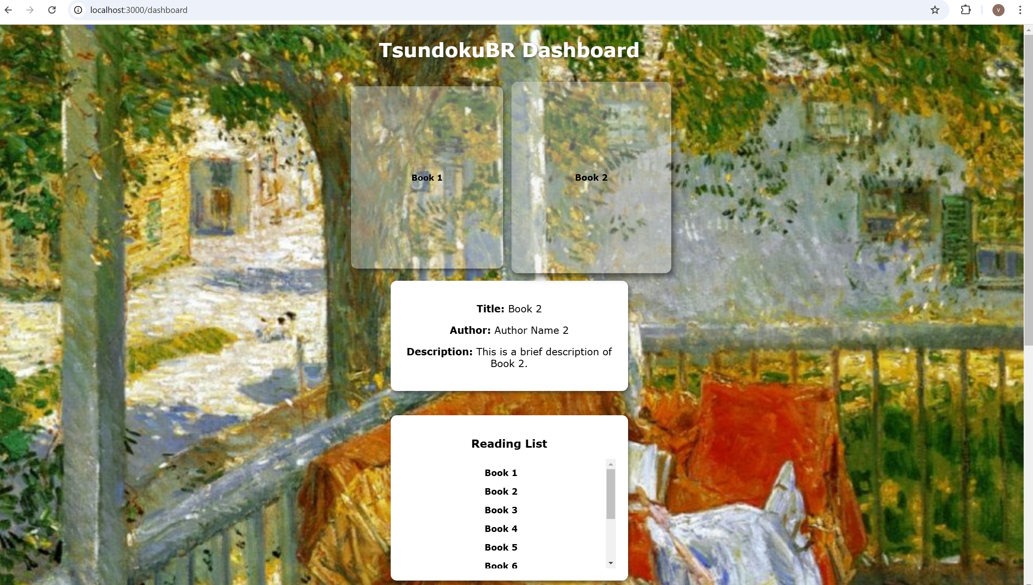
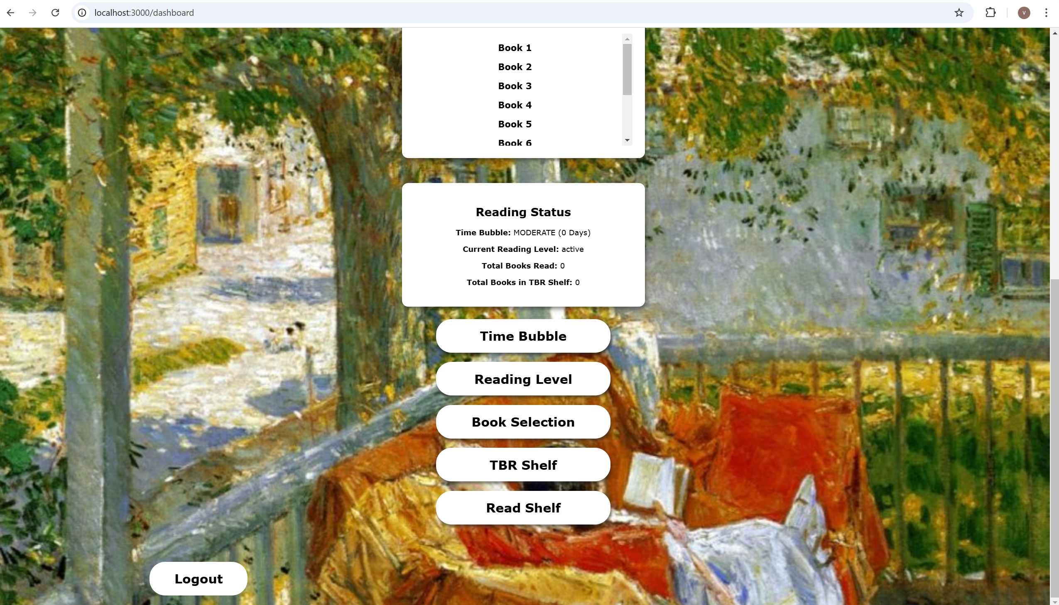
Screens Developed

Slide 7
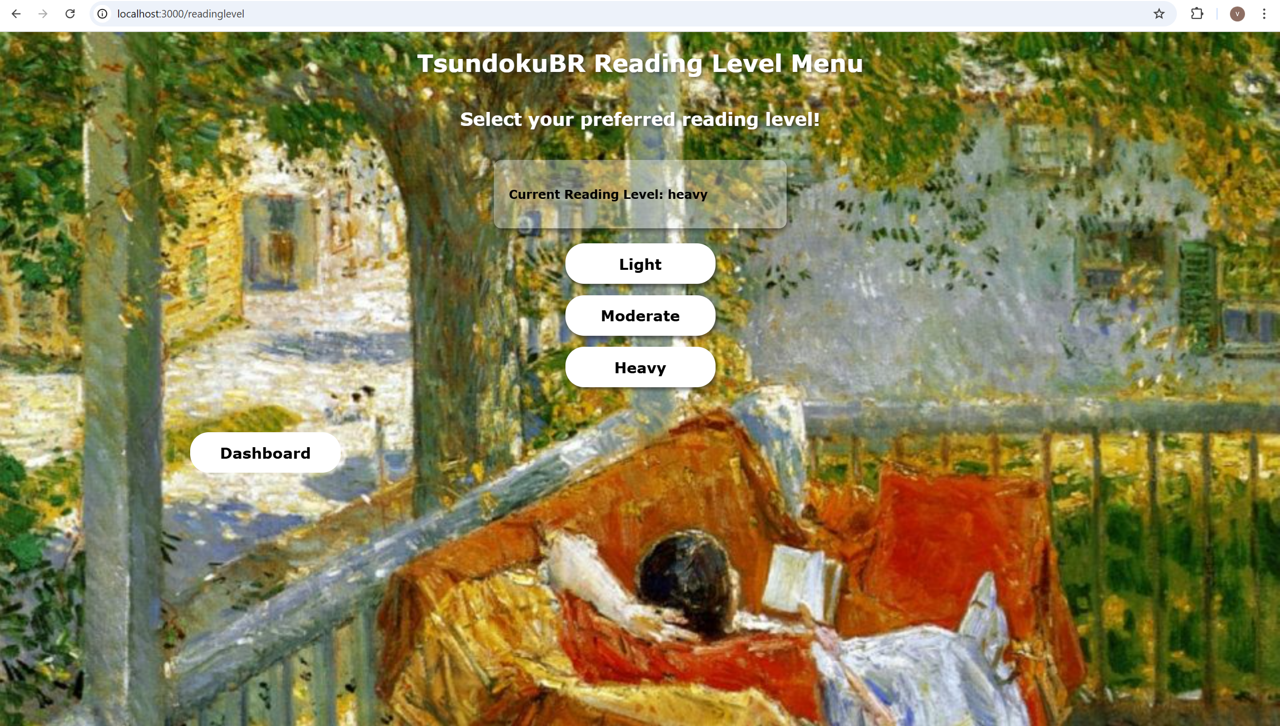
Screens Developed

Slide 8
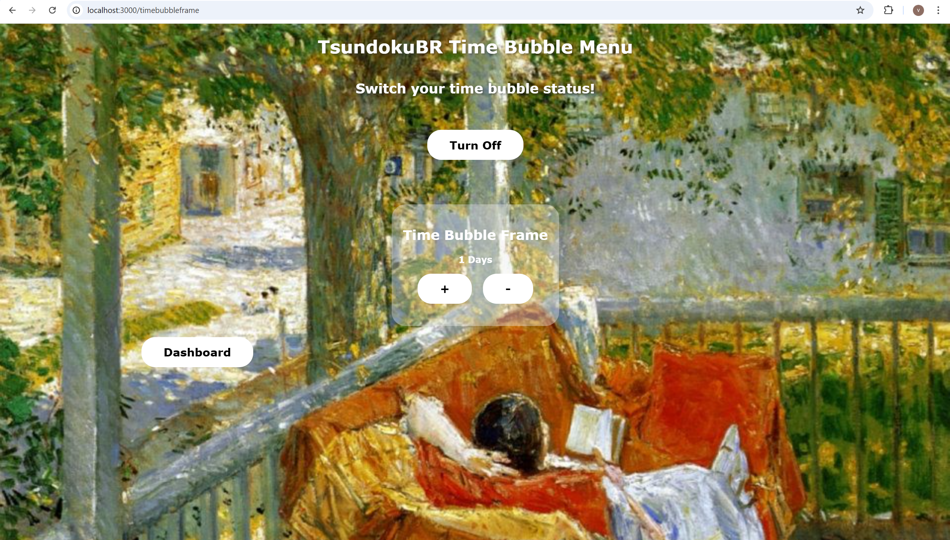
Screens Developed

Slide 9
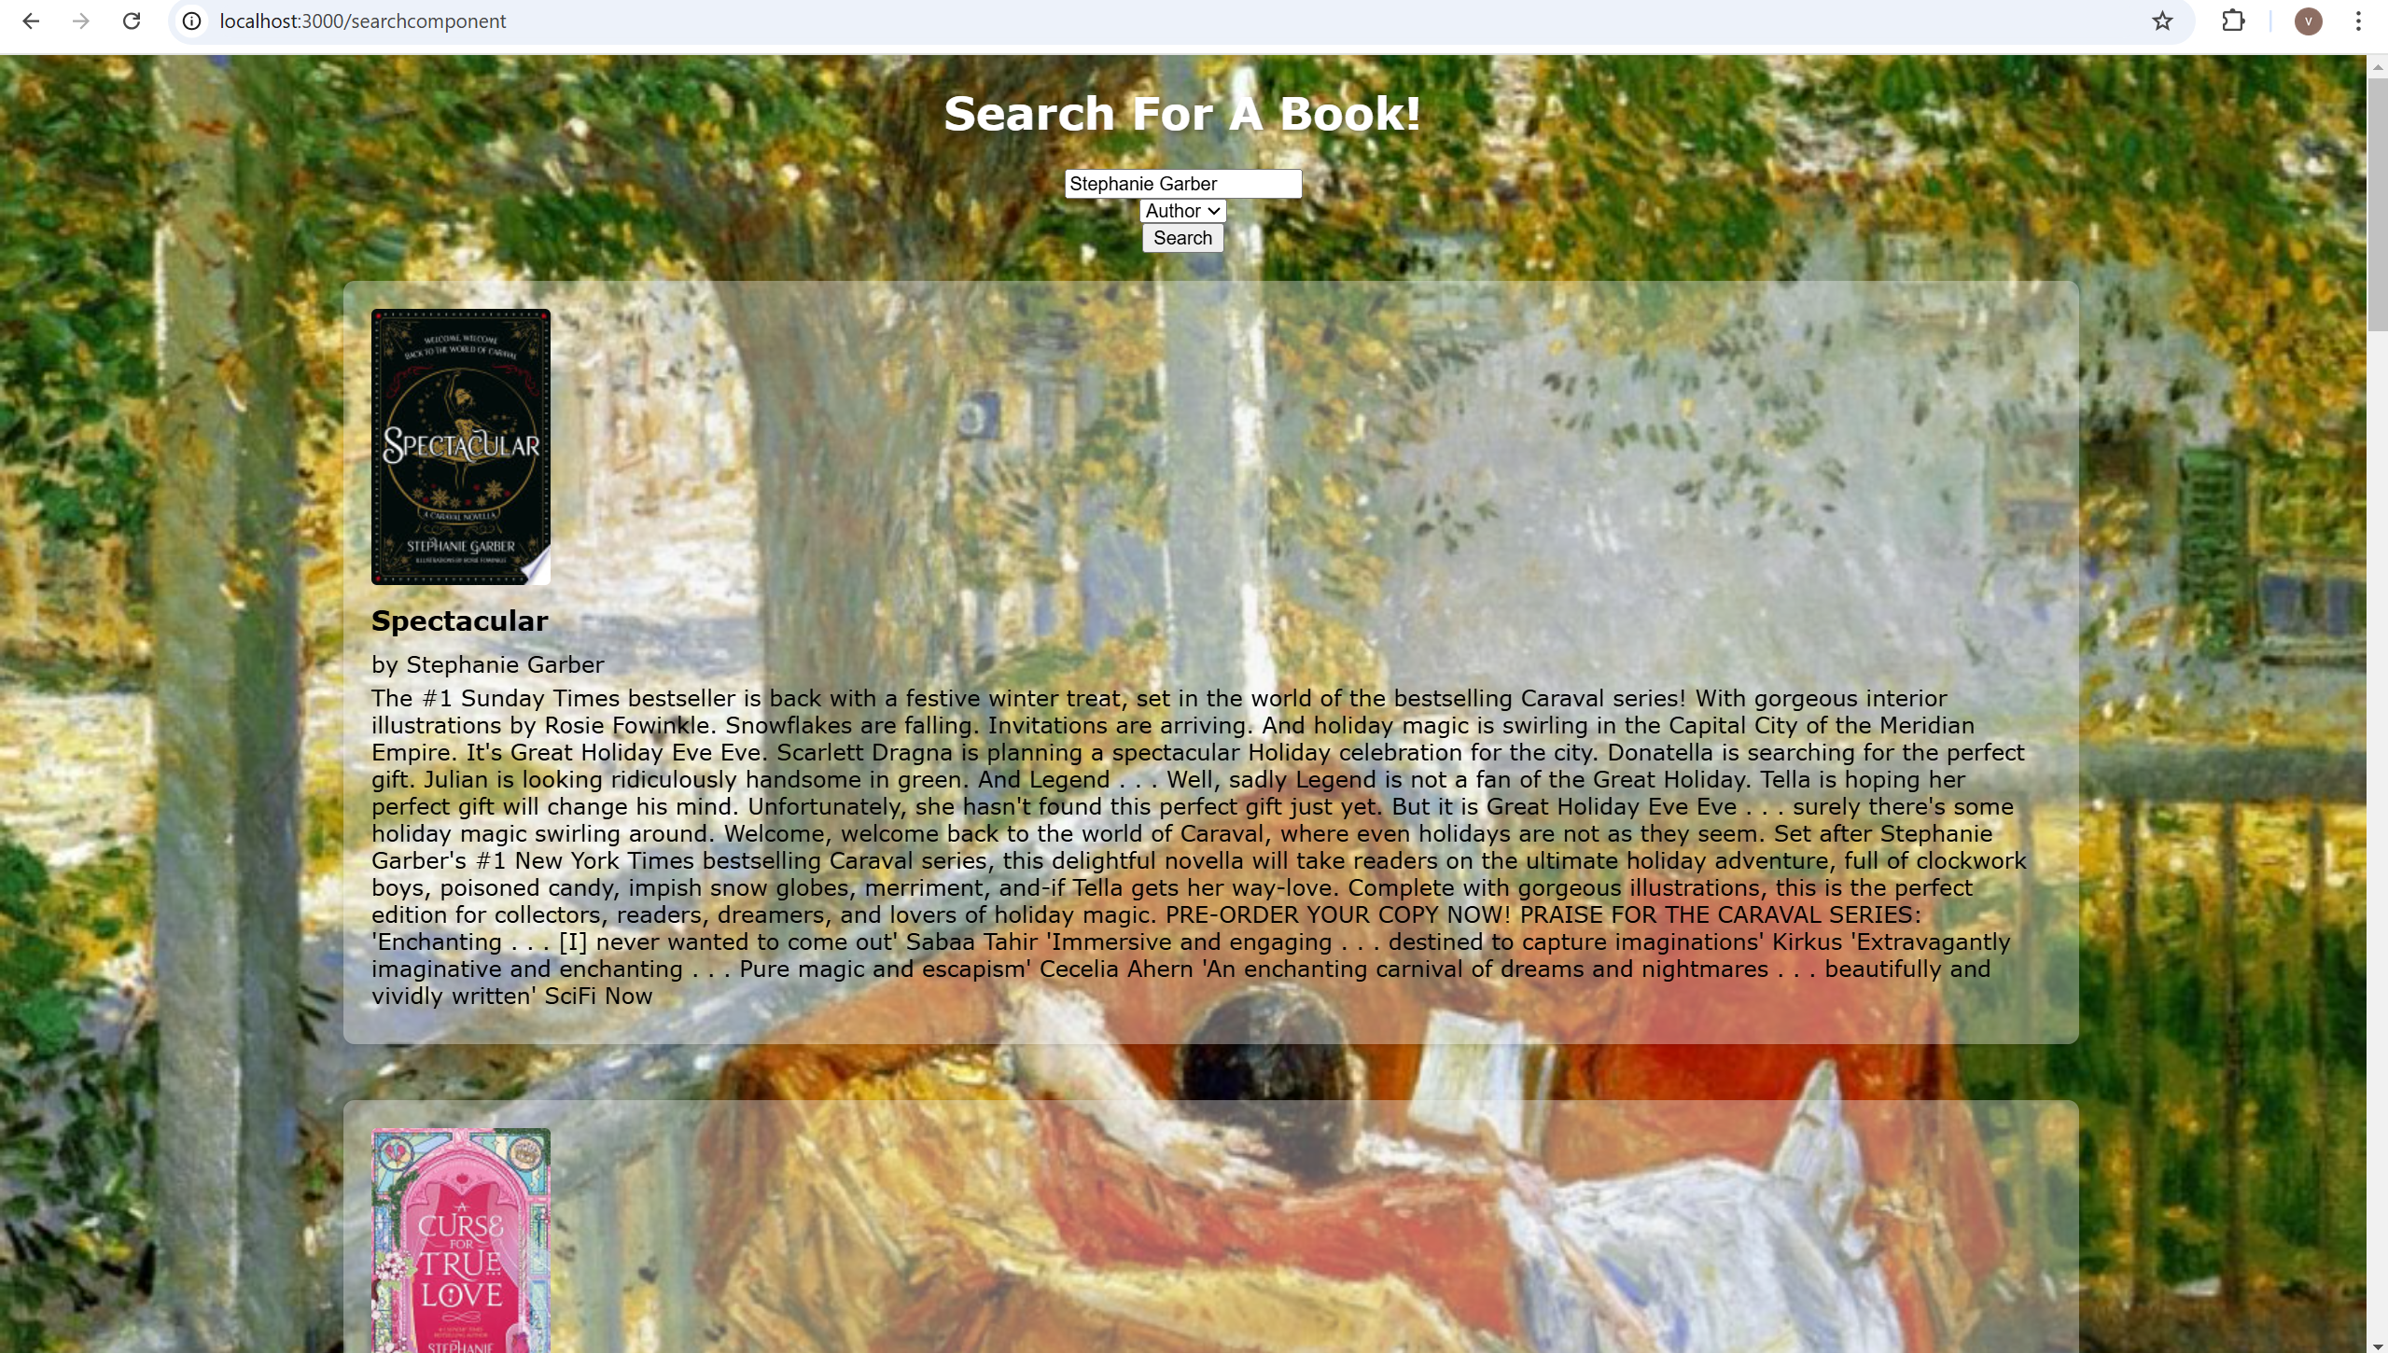
Screens Developed

Slide 10
What’s next
Get runners set up for CI pipeline
Test driven development
Set up: remaining features + Database
An issue I ran into while trying to set up a .gitlab-ci pipeline was the script was getting stuck at the build stage; upon further inspection I noticed that runners were not set up yet.
Developing tests as code functionality if implemented to ensure that the whole system works seamlessly and to ensure bugs and errors are handled at earlier stages.
Allocation of books
Add note to a book
Save a book onto the TBR shelf

Slide 11
THANK YOU

